Slide 1
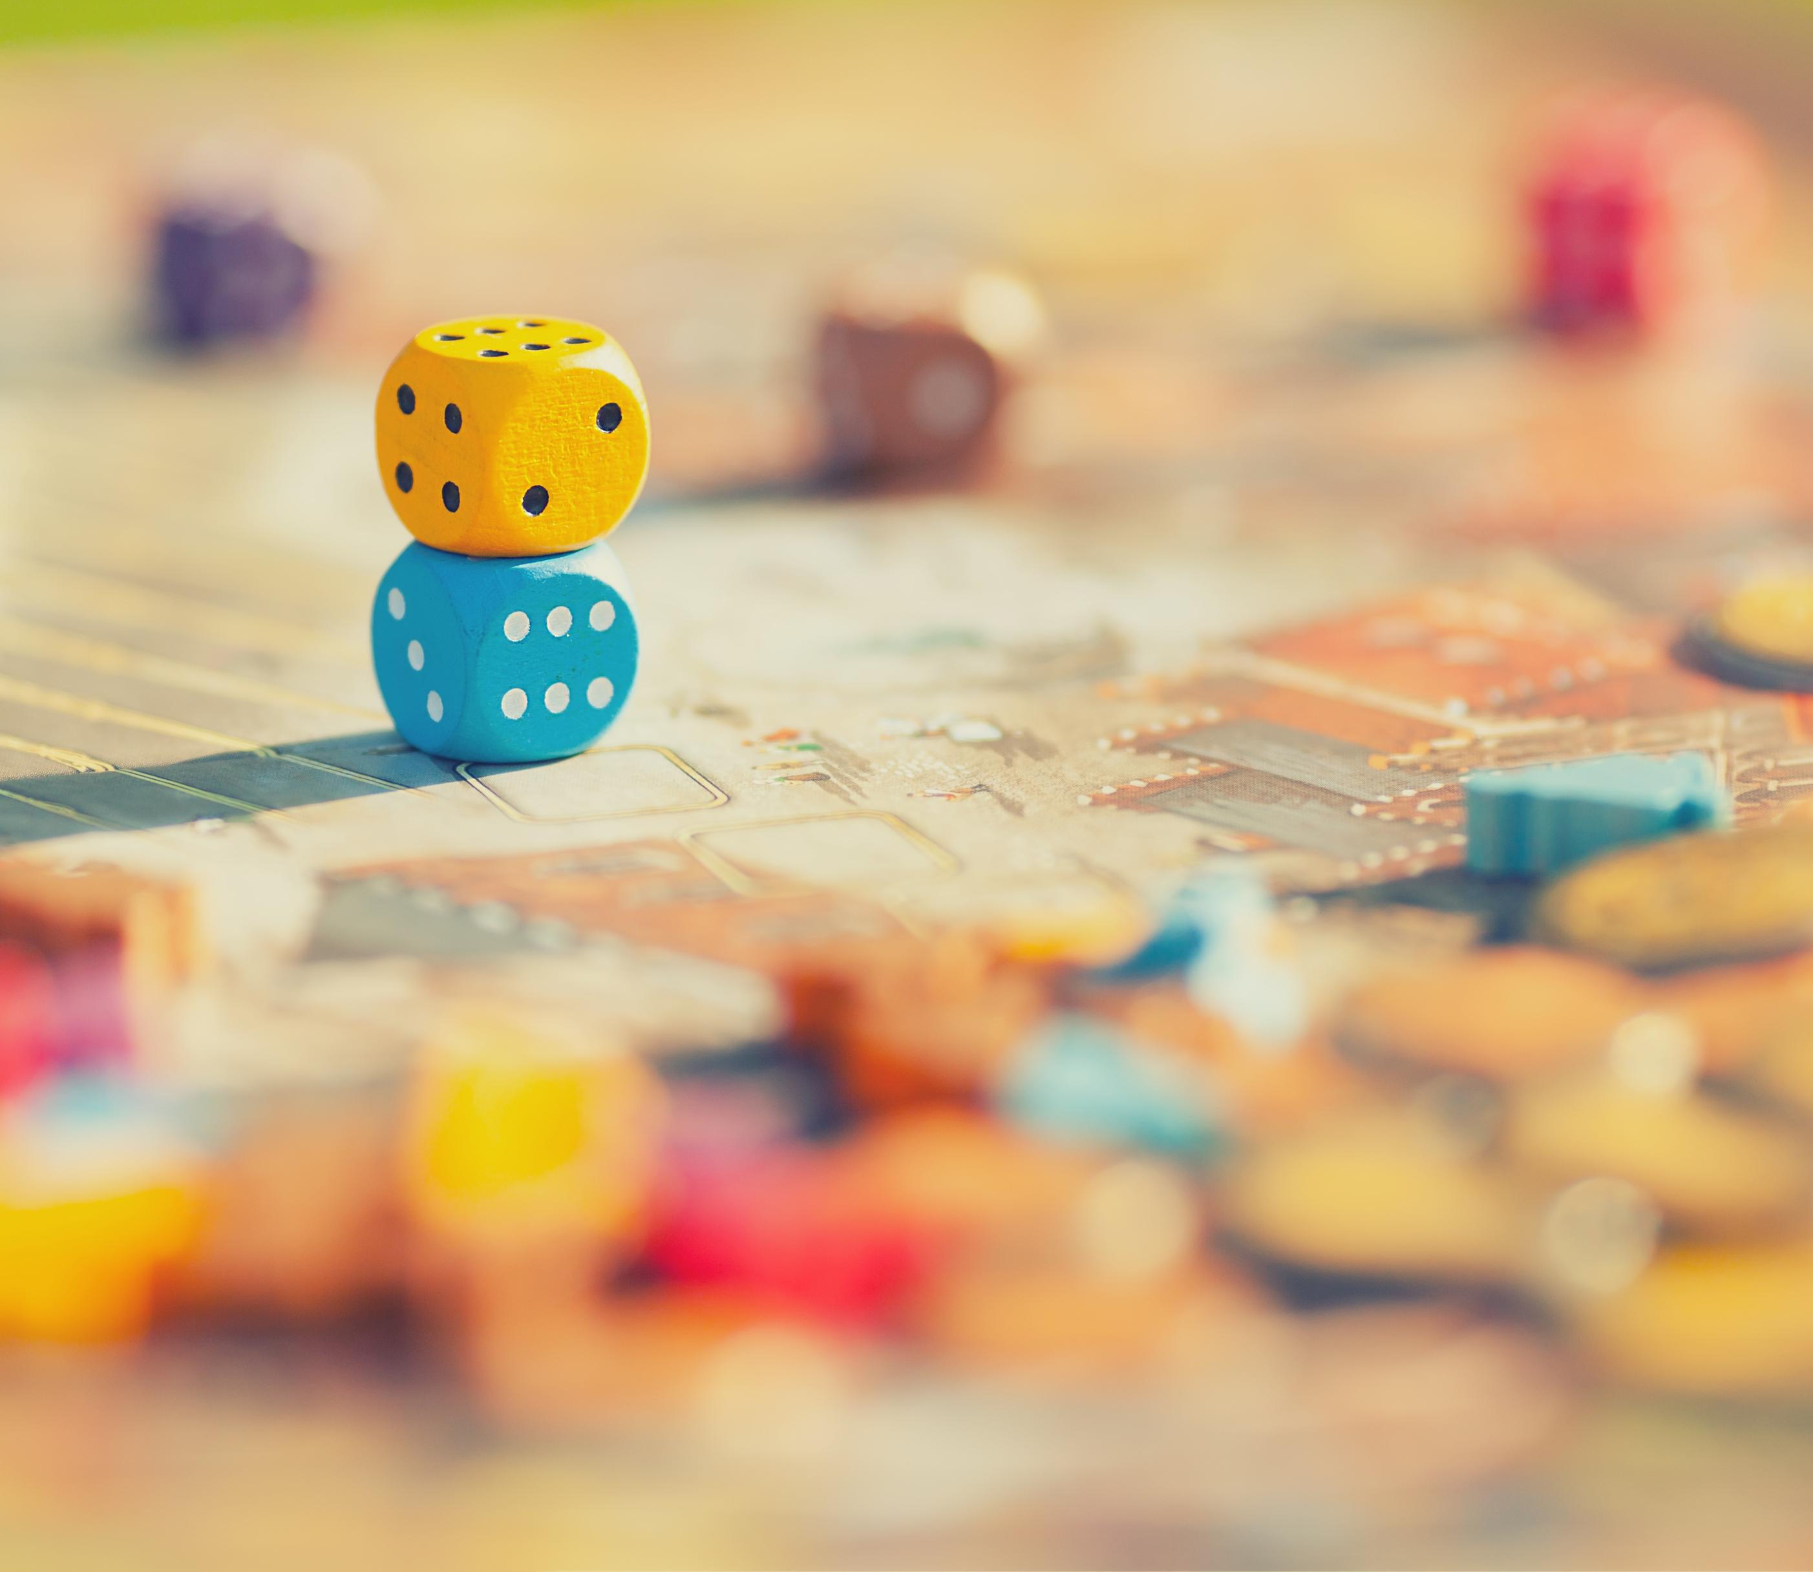
Review: Geometric Distributions
Introduction to Statistics

Slide 2

Example – Part 1
You need to find a store that carries a special printer ink. You know that of the stores that carry printer ink, 10% of them carry the special ink. You randomly call each store until one has the ink you need.
What are the parameters $p$ and $q$ for the model?

Slide 3
Example – Part 2a
You need to find a store that carries a special printer ink. You know that of the stores that carry printer ink, 10% of them carry the special ink. You randomly call each store until one has the ink you need.
What is the probability that you find the correct ink on the fifth call?

Slide 4
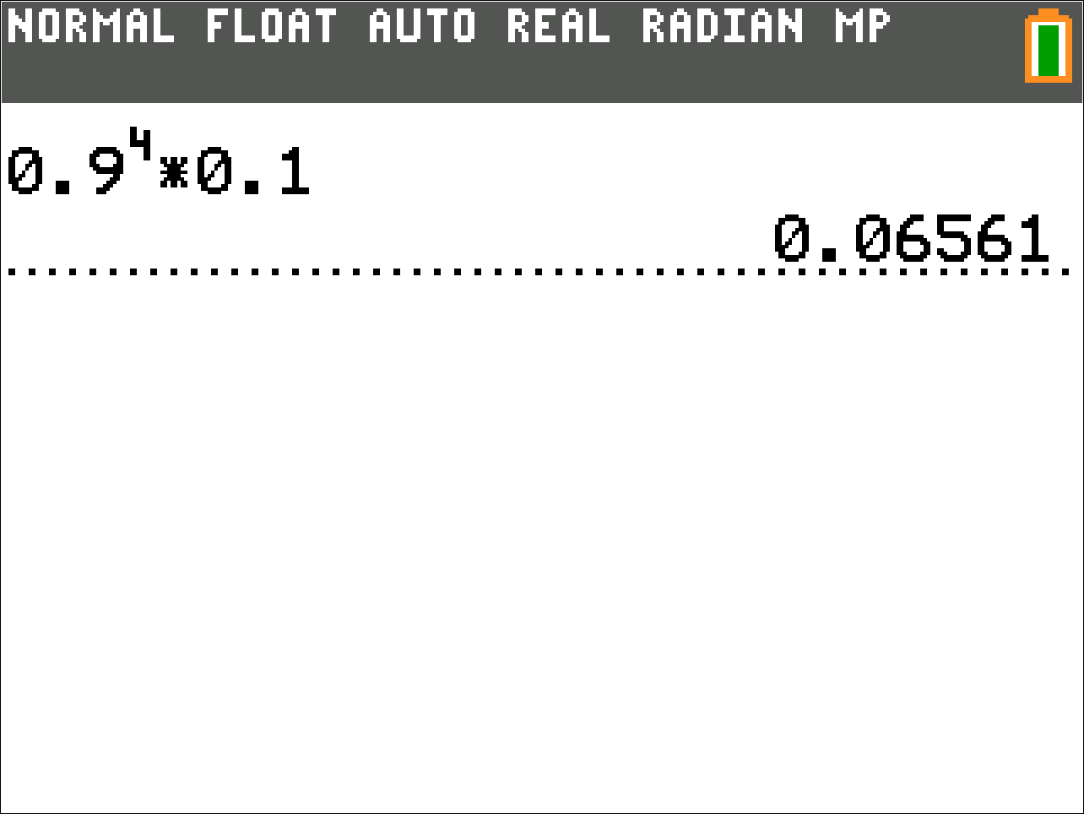
Example – Part 2b
You need to find a store that carries a special printer ink. You know that of the stores that carry printer ink, 10% of them carry the special ink. You randomly call each store until one has the ink you need.
What is the probability that you find the correct ink on the fifth call?

Slide 5
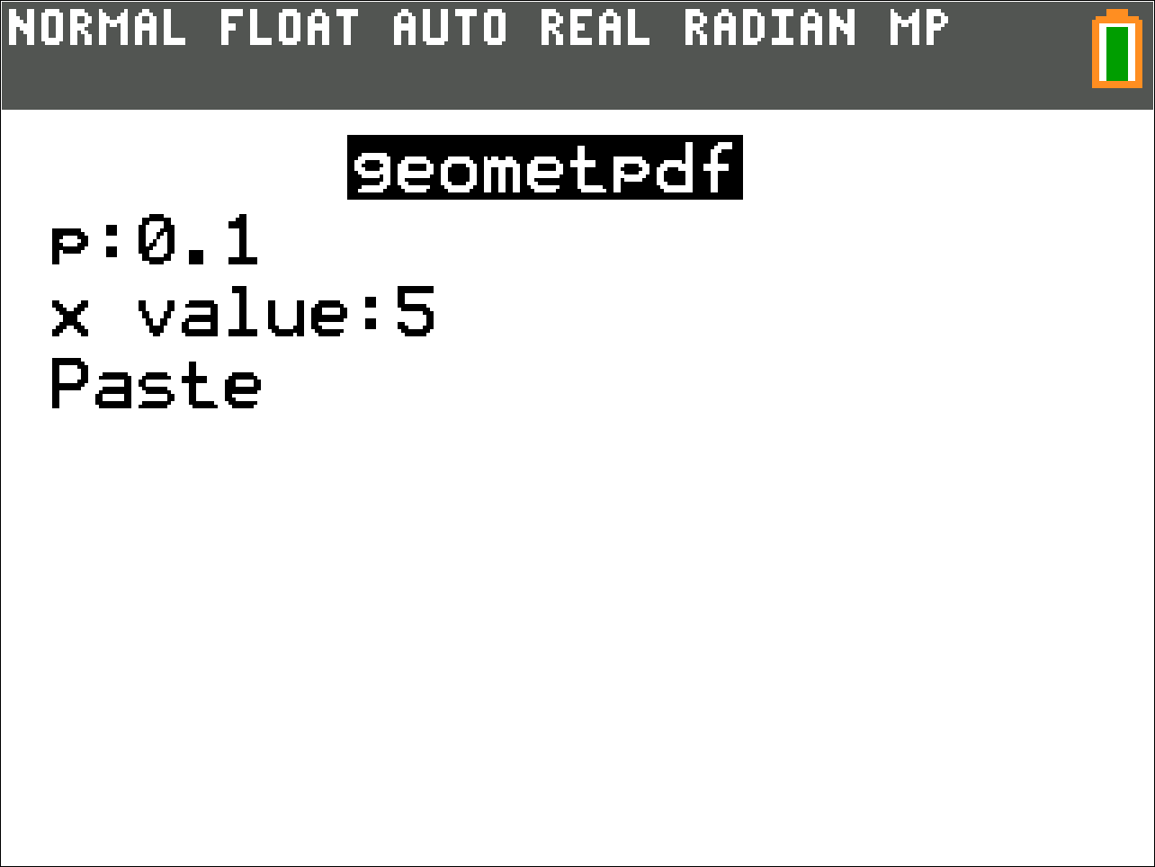
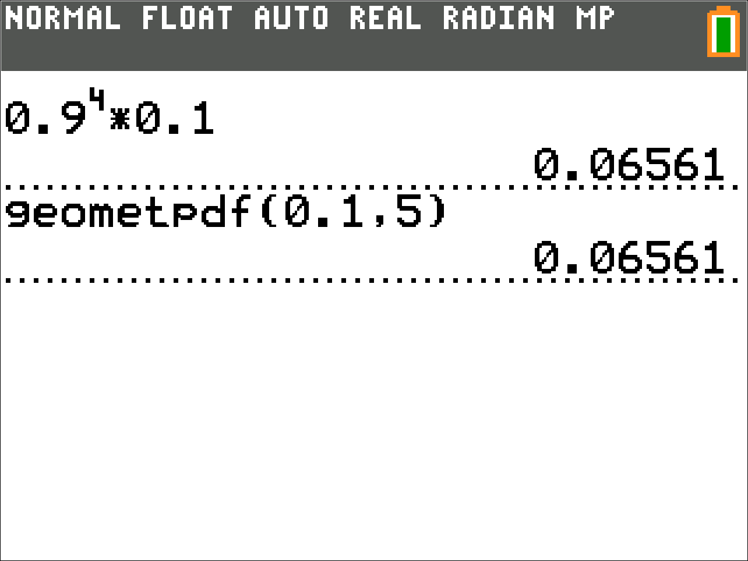
Example – Part 2c
You need to find a store that carries a special printer ink. You know that of the stores that carry printer ink, 10% of them carry the special ink. You randomly call each store until one has the ink you need.
What is the probability that you find the correct ink on the fifth call?

Slide 6
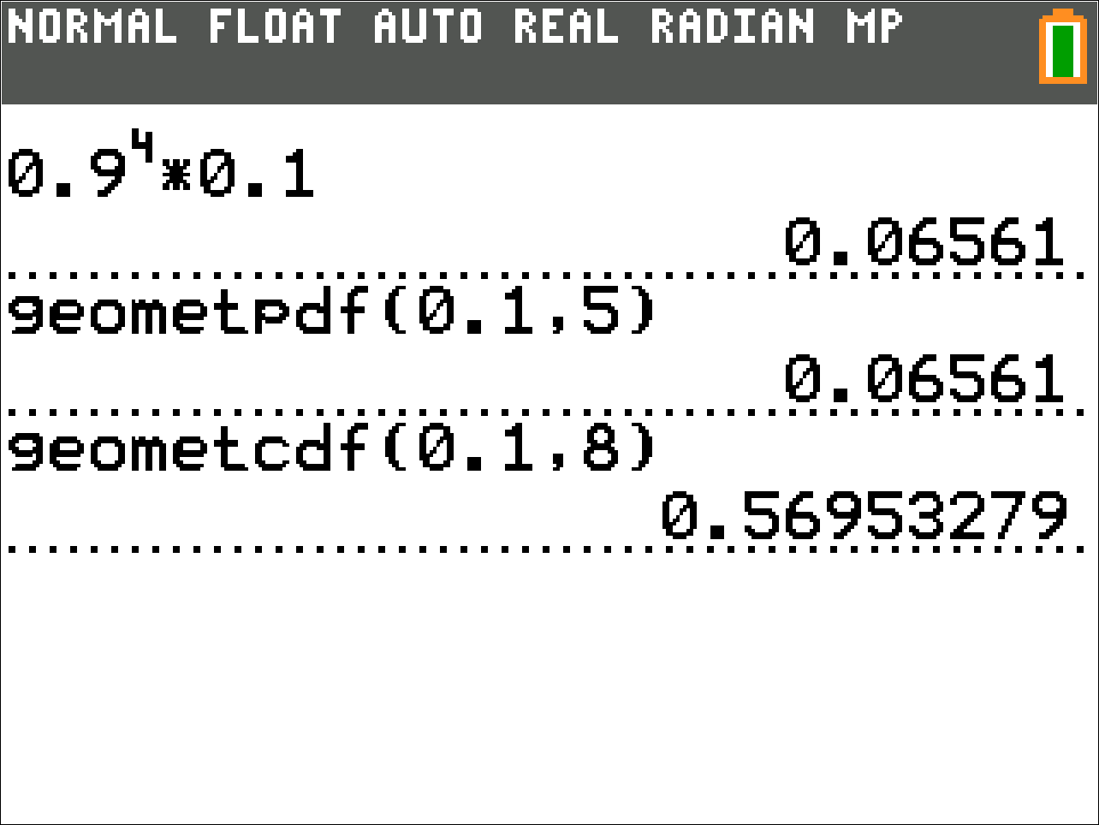
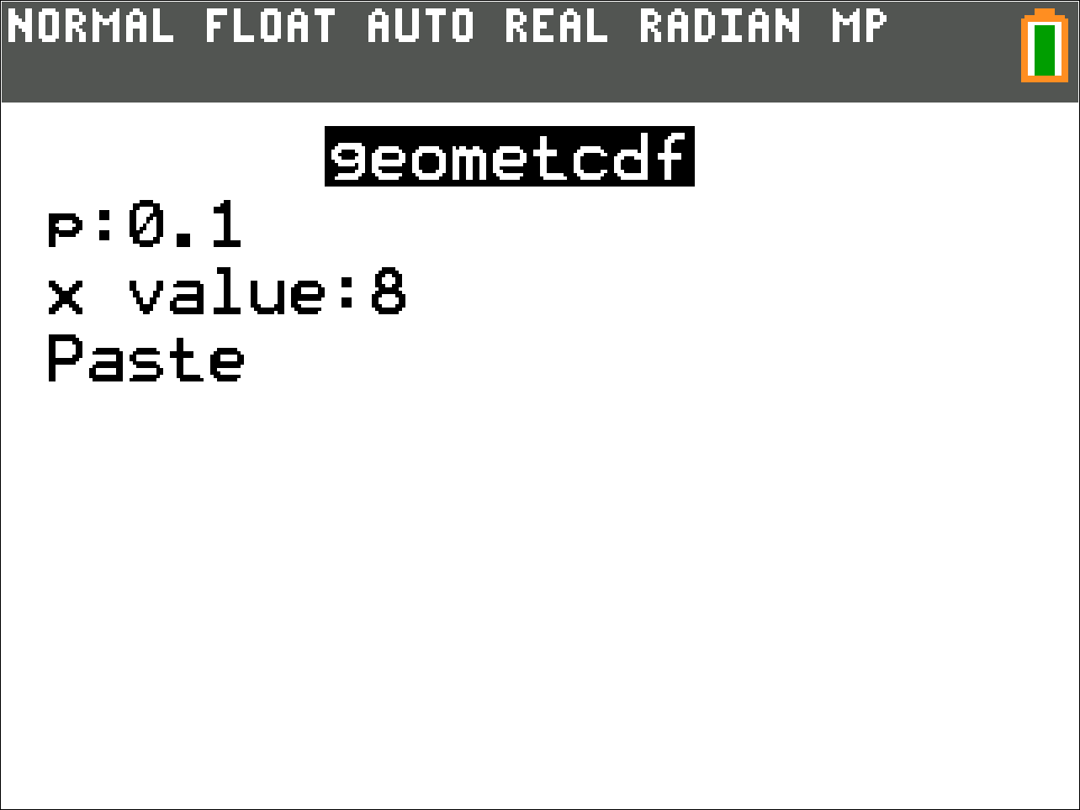
Example – Part 3
You need to find a store that carries a special printer ink. You know that of the stores that carry printer ink, 10% of them carry the special ink. You randomly call each store until one has the ink you need.
What is the probability you call a store with the correct ink in at most 8 tries?

Slide 7
Example – Part 4
You need to find a store that carries a special printer ink. You know that of the stores that carry printer ink, 10% of them carry the special ink. You randomly call each store until one has the ink you need.
What is the expected number of calls you make to find the correct ink?

Slide 8
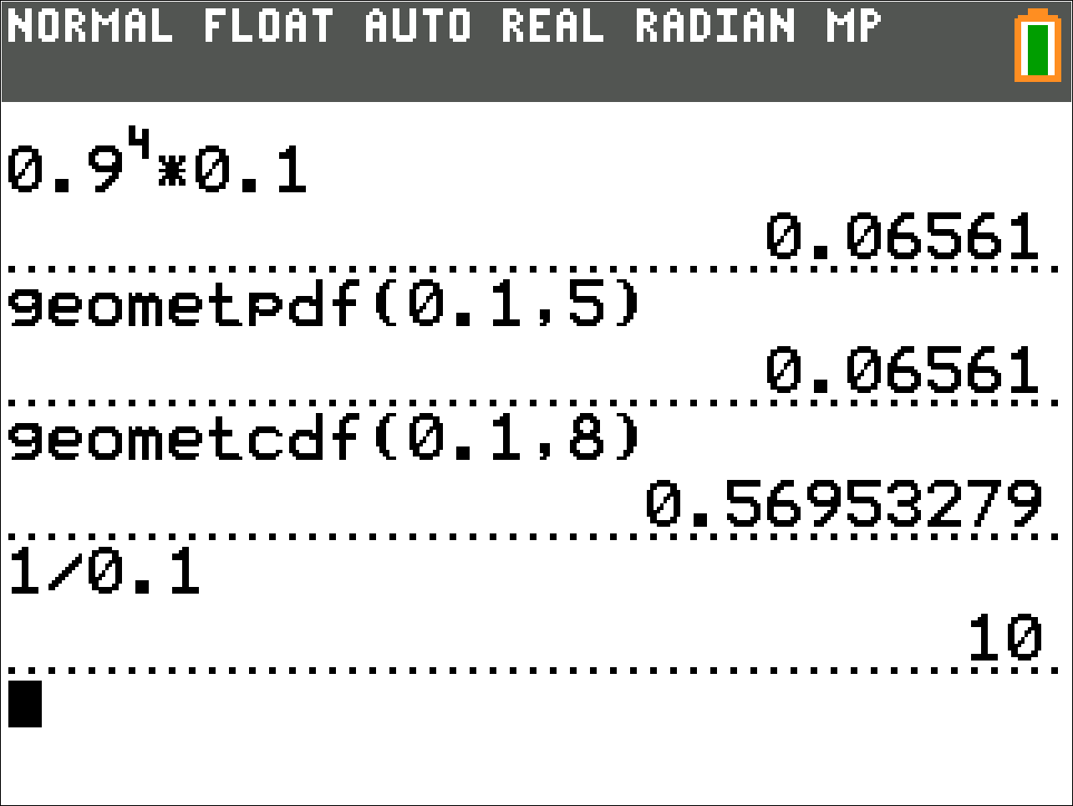
Example – Part 4
You need to find a store that carries a special printer ink. You know that of the stores that carry printer ink, 10% of them carry the special ink. You randomly call each store until one has the ink you need.
What is the expected number of calls you make to find the correct ink?

Slide 9
Example – Part 5
You need to find a store that carries a special printer ink. You know that of the stores that carry printer ink, 10% of them carry the special ink. You randomly call each store until one has the ink you need.
What is the standard deviation of calls you make to find the correct ink?

Slide 10
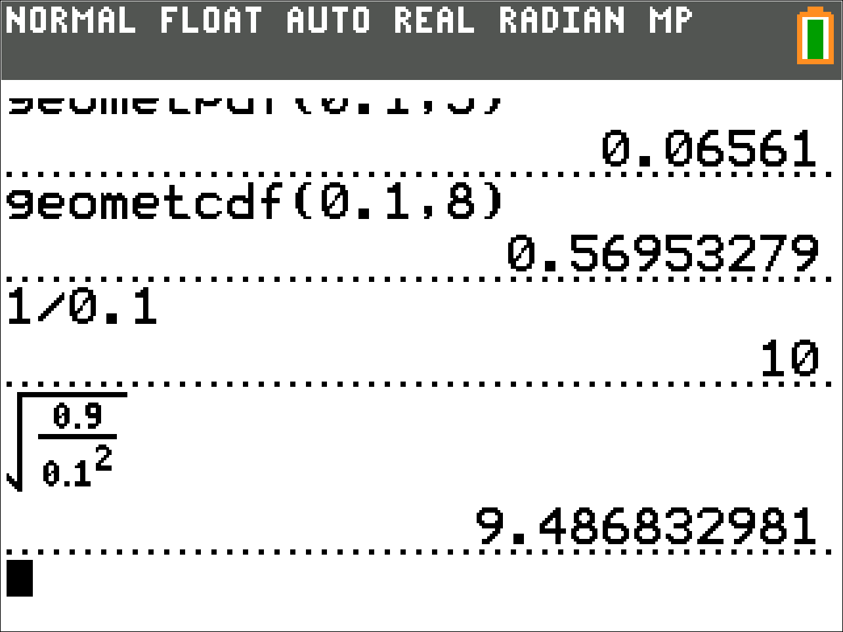
Example – Part 5
You need to find a store that carries a special printer ink. You know that of the stores that carry printer ink, 10% of them carry the special ink. You randomly call each store until one has the ink you need.
What is the standard deviation of calls you make to find the correct ink?

Slide 11
Example – Part 6
You need to find a store that carries a special printer ink. You know that of the stores that carry printer ink, 10% of them carry the special ink. You randomly call each store until one has the ink you need.
There are some issues with this problem. Comment below with any implicit assumptions I made about the problem.

